Slide 1

Predicting customer buying behaviour
By
AKILESH S

Slide 2
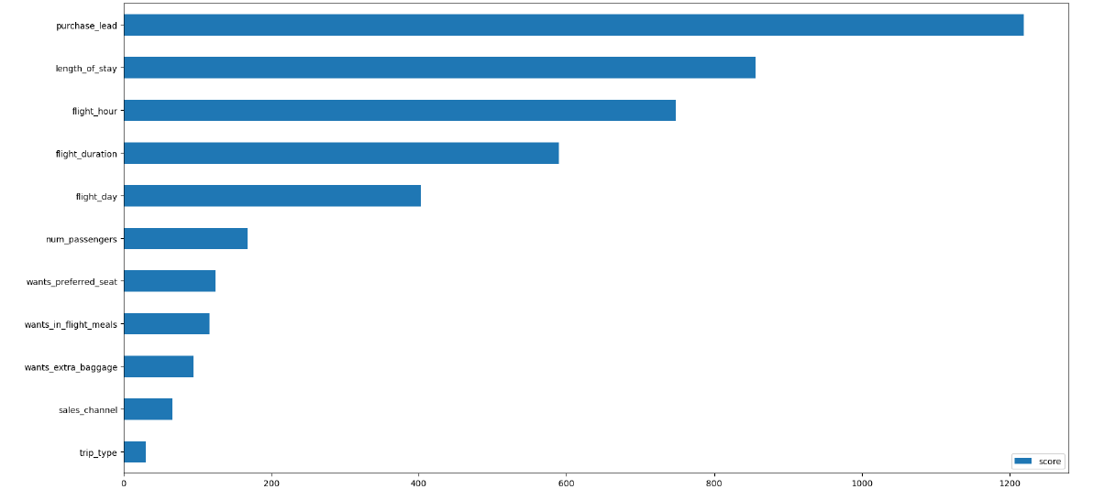
predictive model to understand factors that influence buying behaviour
I have trained the data set with XGBoost classifier model and received
ACCURACY: 83%
AUC score: 0.544
Purchase_land
Length_of_stay
Flight_hour
Flight_duaration
Flight_day
are the top 5 features which influence Customer buying behavior.
We need to increase the AUC score.

